Slide 1
Unit-4
Tree and Graph

Slide 2
Basic Terminologies
Tree :
Tree data structure is a hierarchical structure that is used to represent and organize data in the form of parent child relationship.
The topmost node of the tree is called the root, and the nodes below it are called the child nodes. Each node can have multiple child nodes, and these child nodes can also have their own child nodes.

Slide 3
Basic Terminologies
Tree :
A tree consists of a finite set of elements, called nodes, and a finite set of directed lines called branches, that connect nodes.
Degree :
The no. of branches associated with a node is the degree of the node.
When the branch is directed toward the node, it is an in-degree branch ; when the branch is directed away from the node, it is an out-degree branch.
The sum of in-degree and out-degree braches is
the degree of the node.

Slide 4
Basic Terminologies
In-degree :
In-degree of a node is the number of edges arriving at that node.In-degree = arrows coming in
Out-degree :
Out-degree of a node is the number of edges leaving that node.In-degree = arrows coming out

Slide 5
Basic Terminologies
Root :
If the tree is not empty, then the first node is called the root.
The in-degree of the root is by definition, zero.
Leaf :
A leaf is any node with an out-degree of zero, i.e, the node without a children.
Internal node :
A node that is not a root or a leaf is known as internal node because it is found in the middle portion of a tree.

Slide 6
Basic Terminologies
Parent :
A node is a parent if it has successor nodes - that is, if it has an out-degree greater than zero.
Child :
A node with a predecessor is a child. A child
node has an in-degree of one.
Siblings :
Two or more nodes with the same parent are siblings.

Slide 7
Basic Terminologies
Level :
The level of a node is its distance from the root.
Because the root has a zero distance from itself, the root is at level zero.
Height:
The height of a node is the length of the longest downward path to a leaf node from that node.
The height of the root node is the height of the tree.
Depth :
Tree is drawn upside down, so no. of levels can be referred as depth of the tree.

Slide 8
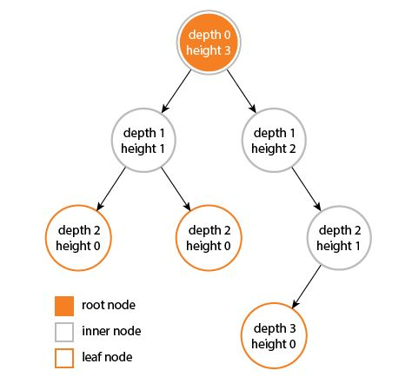
Basic Terminologies

Slide 9
Basic Terminologies
Ancestor :
An ancestor is any node in the path from root to the node.
Descendent :
A descendent is any node in the path below the parent node. i.e. all nodes in the path from a given node to a leaf node are descendents of the node.
Node :
Each element in a tree is known as node of a tree.

Slide 10
A
/ \
B C
/ \
D E
Ancestors of E = {A, C}
Ancestors of D = {A, C}
Ancestors of C = {A}
Root A has no ancestors.

Slide 11
Descendants of C = {D, E}
Descendants of A = {B, C, D, E}
Descendants of B = {} (none, since it’s a leaf).

Slide 12
Basic Terminologies
Forest :-
A forest is a set of n>=0 disjoint trees, where n represents no. of nodes in the tree. The meaning of a forest is very close to a tree, because if we remove the root of a tree, we get a forest.
A group of two or more trees that are separate (disjoint),meaning there is no direct connection between them.
Directed Tree :
It is an acyclic digraph which has one node called its root, with in-degree 0, while all other nodes have in-degree 1.
Terminal Node and Branch Node :
In a directed tree, any node which has out-degree 0 is called terminal node or leaf; all other nodes are known as branch nodes.

Slide 13
Basic Terminologies
Ordered Tree:
If in a directed tree an ordering of the nodes at each level is prescribed, then such a tree is called an ordered tree. Order can be given from left to right at each level.
General Tree
A general tree is tree in which each node can have an unlimited out – degree.
Each node may have as many children as is necessary to satisfy its requirements.

Slide 14
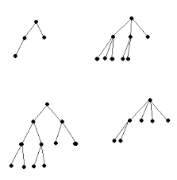
M-ary Tree
If in a directed tree the out degree of every node is less than or equal to m, then the tree is called an m-ary tree.
A tree is called an M-ary tree if every internal node has no more than M children. M means maximum number of children
The tree is called full M-ary tree if every internal node has exactly M children.
An M-ary tree with M=2 is called a binary tree.

Slide 15
Binary Tree
A Binary tree is a special case of tree in which no node of a tree can have more than two nodes.
For a binary tree, it has been found that:
The maximum number of nodes at level i will be 2^{i} .
If d is the depth of the tree then the maximum number of nodes that the tree can have is 2^{d+1}-1.

Slide 16
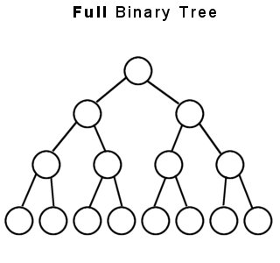
Binary Tree
Full Binary Tree:
A binary tree in which every node other than leaf nodes has two children.A binary tree in which every node other than leaf nodes has two children.Full binary tree (each node has 0 or 2 children).
0 children (leaf), OR
2 children (left & right)

Slide 17
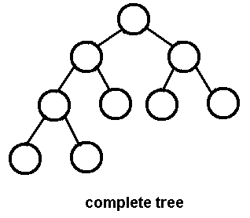
Binary Tree
Complete Binary Tree:
A binary tree in which every level, except possibly the last, is completely filled, and all nodes are as far left as possible.
A binary tree in which every level, except possibly the last, is completely filled, and all nodes are as far left as possible.In a Complete Binary Tree, the last level is filled left to right, even if some nodes have only one child.

Slide 18
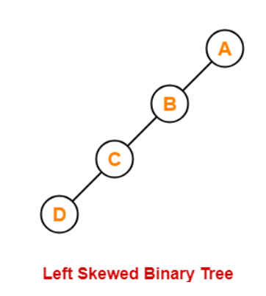
Binary Tree
Left Skewed Binary Tree:
A binary tree in which in every node right sub-tree is missing, is known as Left Skewed Binary Tree.

Slide 19
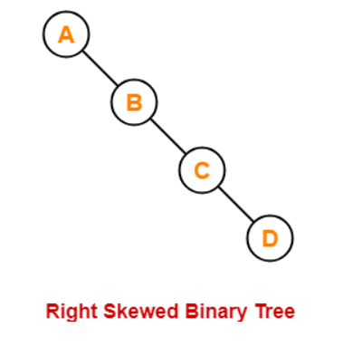
Binary Tree
Right Skewed Binary Tree:
A binary tree in which in every node left sub-tree is missing, is known as Right Skewed Binary Tree.

Slide 20
Expression Tree
An expression tree is a binary tree with the following properties:
Each leaf is an operand.
The root and internal nodes are operators.
Sub-trees are sub-expressions, with the root being an operator.

Slide 21

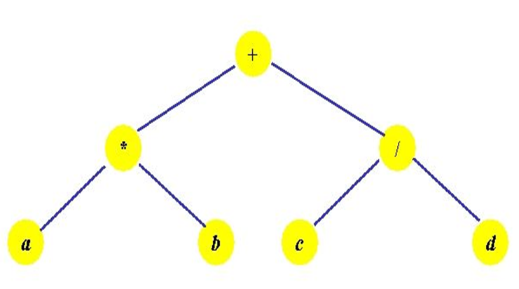
Expression Tree
Expression :

Slide 22
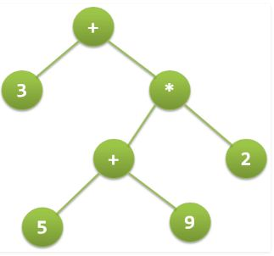
Expression Tree
Expression : 3 + ((5+9)*2)

Slide 23
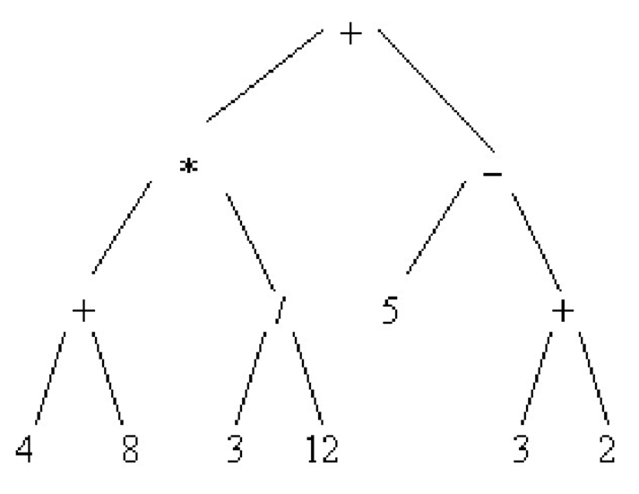
Expression Tree
Expression : (4+8)*(3/12)+(5-(3+2))

Slide 24

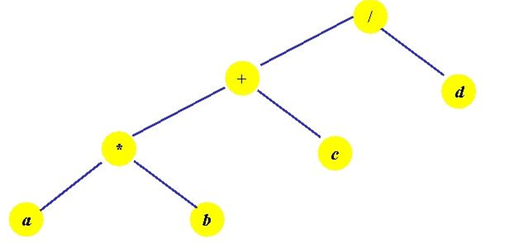
Expression Tree
Expression :

Slide 25
Storage Representation of a Binary Tree
Trees can be represented in two ways:
Array Representation (Static)
Linked Representation (Dynamic)

Slide 26
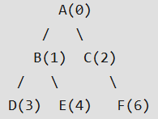
Array Representation
The maximum size of an array is 2^{d+1}-1, where d is the depth of the tree.
If Parent = p, then
left_child = (2*p)+1
right_child = (2*p)+2
Where, parent, left_child and right_child are the values of indices of the array.

Slide 27
Linked Representation
In linked representation of a binary tree, every node will have three parts:
A data element
A pointer to the left node
A pointer to the right node
So in C, the binary tree is built with a node type given as follows:
struct node
{
struct node *left;
int data;
struct node *right;
}

Slide 28
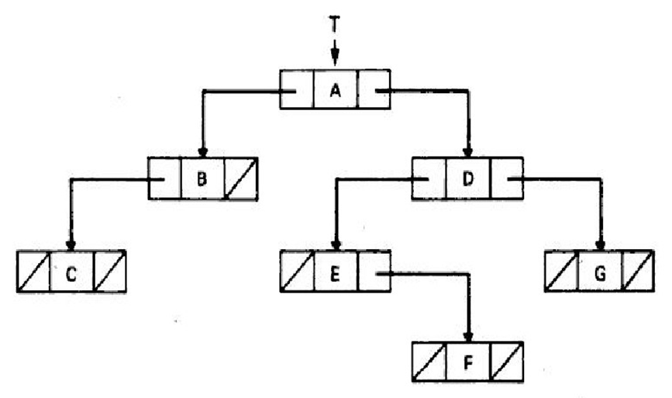
Linked Representation

Slide 29
Traversal of Binary Trees
Traversing a binary tree is the process in which each node in the tree should be visited exactly once, in a systematic way.
Unlike linear data structures in which the elements are traversed sequentially, a tree is a non-linear data structure in which the elements can be traversed in many different ways.
There are many different ways for tree traversals.
These ways differ in the order in which the nodes are visited.

Slide 30
Traversal of Binary Trees
Following are the different ways in which a binary tree can be traversed:
Preorder Traversal
Inorder Traversal
Postorder Traversal

Slide 31
Preorder Traversal
To traverse a non-empty binary tree in preorder, the following operations are performed recursively at each node.
The traversal starts with the root node of the tree and continues by:
Visiting the root node.
Traversing the left sub-tree.
Traversing the right sub-tree.

Slide 32
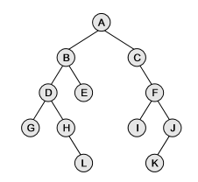
Preorder Traversal
Pre-Order Traversal: A,B,D,G,H,L,E,C,F,I,J,K

Slide 33
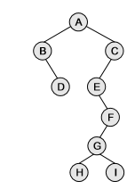
Preorder Traversal
Pre-Order Traversal: A,B,D,C,E,F,G,H,I

Slide 34
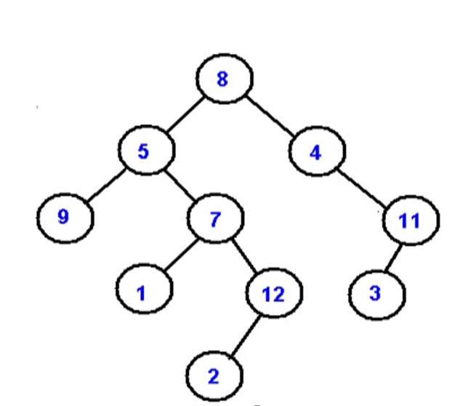
Preorder Traversal
Pre-Order Traversal: 8, 5, 9, 7, 1, 12, 2, 4, 11, 3

Slide 35
Inorder Traversal
To traverse a non-empty binary tree in inorder, the following operations are performed recursively at each node.
The traversal starts with the root node of the tree and continues by:
Traversing the left sub-tree.
Visiting the root node.
Traversing the right sub-tree.

Slide 36
Inorder Traversal
In-Order Traversal: G,D,H,L,B,E,A,C,I,F,K,J

Slide 37
Inorder Traversal
In-Order Traversal: B,D,A,E,H,G,I,F,C

Slide 38
Inorder Traversal
In-Order Traversal: 9, 5, 1, 7, 2, 12, 8, 4, 3, 11

Slide 39
Postorder Traversal
To traverse a non-empty binary tree in postorder, the following operations are performed recursively at each node.
The traversal starts with the root node of the tree and continues by:
Traversing the left sub-tree.
Traversing the right sub-tree.
Visiting the root node.

Slide 40
Postorder Traversal
Post-Order Traversal: G,L,H,D,E,B,I,K,J,F,C,A

Slide 41
Postorder Traversal
Post-Order Traversal: D,B,H,I,G,F,E,C,A

Slide 42
Postorder Traversal
Post-Order Traversal: 9, 1, 2, 12, 7, 5, 3, 11, 4, 8

Slide 43
Traversal of Binary Trees
If the words right and left are interchanged then three new traversals are possible:
Converse Preorder Traversal : Root – Right – Left
Converse Inorder Traversal : Right – Root – Left
Converse Postorder Traversal : Right – Left – Root

Slide 44
Traversal of Binary Trees
Example : Find Post-order for given : (REFER CLASS-BOOK)
In-order : E A C K F H D B G
Pre-order : F A E K C D H G B
Post-order (Answer) : E C K A H B G D F
First See the Preorder. Which element is first in preorder
Take that element as a ROOT.
So in this example in Preorder part “F” Becomes Root.
Because F is the first element in Preorder.
Now Check in Inorder where F exist in Inorder.

Slide 45
Traversal of Binary Trees
Inorder = E A C K F H D B G
Preorder = F A E K C D H G B
So in Inorder F is there at middle whichever element is
Of Left side of F becomes Left Element Whichever is at
Right side becomes right elements.

Slide 46
Traversal of Binary Trees
Inorder = E A C K F H D B G
Preorder = F A E K C D H G B
Now Don’t see InOrder work for Inorder is over.
Now check one by one element in Preorder. Whichever element is there after Root that is F is considered as a next root. So Next Element after F is A so now A is become next Root. Whichever element is Left side of A becomes its Left Element whichever is right side of A becomes it Right Element. Now check Next Element that is E then E becomes root. And so on...
F
E A C K
H D B G

Slide 47
Traversal of Binary Trees
Inorder = E A C K F H D B G
Preorder = F A E K C D H G B
F
E A C K
H D B G
E
C K
H
B G
C
B

Slide 48
Traversal of Binary Trees
Now from above result find out Binary Tree
F
A
D
E
K
H
G
C
B

Slide 49
Traversal of Binary Trees
Now Find out Post Order from Above Tree..
That is Left,Right and Root.
So Post order of above tree is..
E C K A H B G D F

Slide 50
Traversal of Binary Trees
Example : Find Post-order for given : (REFER CLASS-BOOK)
Pre-order : A B D H E C F G I J
In-order : D H B E A F C I G J
Post-order (Answer) : H D E B F I J G C A

Slide 51
Traversal of Binary Trees
Example : Find Post-order for given : (REFER CLASS-BOOK)
Pre-order : 1 2 4 3 5 7 8 6
In-order : 4 2 1 7 5 8 3 6
Post-order (Answer) : 4 2 7 8 5 6 3 1

Slide 52
Traversal of Binary Trees
Example : Find Pre-order for given : (REFER CLASS-BOOK)
In-order : D B E A F C G
Post-order : D E B F G C A
Pre-order (Answer) : A B D E C F G
First See the Postorder. Which element is Last in postorder
Take that element as a ROOT.
So in this example in Postorder “A” Becomes Root.
Because A is the last element in PostOrder.
Now Check in Inorder where A exist in Inorder.

Slide 53
Traversal of Binary Trees
Inorder = D B E A F C G
Postorder = D E B F G C A
So in Inorder A is there at middle whichever element is
Of Left side of A becomes Left Element Whichever is at
Right side becomes right elements.

Slide 54
Traversal of Binary Trees
Inorder = D B E A F C G
Postorder = D E B F G C A
A
D B E
F C G
Now Don’t see InOrder work for Inorder is over.
Now check one by one element in Post order from Last. Whichever element is there before Root that is C is considered as a next root. So Next Element after A is C so now C is become next Root. Whichever element is Left side of C becomes its Left Element whichever is right side of C becomes it Right Element. Now check previous Element that is G then G becomes root. And so on...

Slide 55
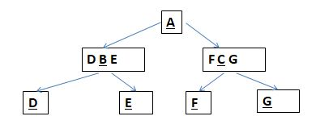
Traversal of Binary Trees
Inorder = D B E A F C G
Postorder = D E B F G C A

Slide 56
Traversal of Binary Trees
Now from above result find out Binary Tree
A
B
C
D
E
F
G
Now Find out Preorder from Above Tree.. That is Root Left and Right
So Preorder of above tree is..
A B D E C F G

Slide 57
Traversal of Binary Trees
Example : Find Pre-order for given : (REFER CLASS-BOOK)
Post-order: 4 2 7 8 5 6 3 1
In-order : 4 2 1 7 5 8 3 6
Pre-order (Answer) : 1 2 4 3 5 7 8 6

Slide 58
Traversal of Binary Trees
Example : Find Pre-order for given : (REFER CLASS-BOOK)
Post-order: 4 5 2 6 3 1
In-order : 4 2 5 1 3 6
Pre-order (Answer) : 1 2 4 5 3 6

Slide 59
Traversal of Binary Trees
Example : Find Pre-order for given : (REFER CLASS-BOOK)
Post-order: 16 21 7 1 9 5 12
In-order : 16 7 21 12 1 5 9
Pre-order (Answer) : 12 7 16 21 5 1 9

Slide 60
Traversal of Binary Trees
Example : Find Pre-order for given : (REFER CLASS-BOOK)
Post-order: 9 1 2 12 7 5 3 11 4 8
In-order : 9 5 1 7 2 12 8 4 3 11
Pre-order (Answer) : 8 5 9 7 1 12 2 4 11 3

Slide 61
Lexically Ordered Binary Tree
The creation of binary tree could be based on the information associated with each code.
This ordering could be numerical (either ascending or descending), or it could be a list of names to be kept in lexicographical order.
That is, the left subtree of the tree (or subtree) is to contain nodes whose associated names are lexically less than the name associated with the root node of the tree.
Similarly, the right subtree of the tree (or subtree) is to contain nodes whose associated names are lexically greater than the name associated with the root node of the tree (or subtree).
E.g. Norma, Roger, John, Bill, Leo, Paul, Ken, and Mourice

Slide 62
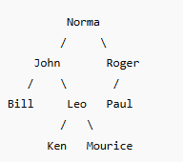
Lexically Ordered Binary Tree

Slide 63
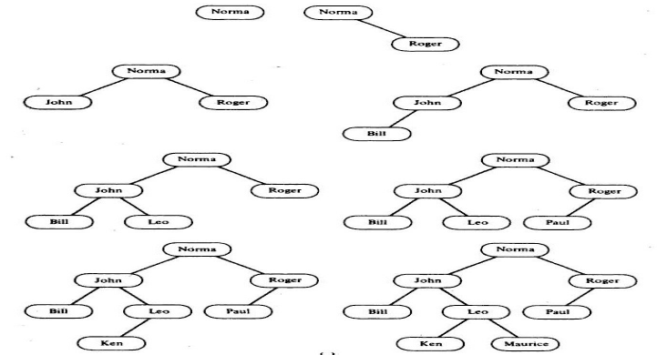

Slide 64
Other Storage representation of binary tree
Venn diagrams
Nesting parentheses
Table of contents
Level – number format
Threaded storage representation

Slide 65
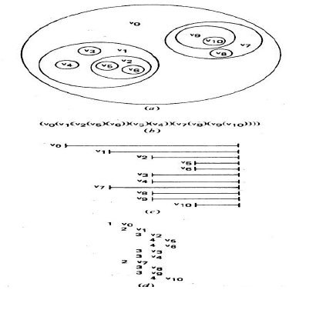
Other Storage representation of binary tree

Slide 66
Threaded Binary Tree
In linked representation of a binary tree, we noticed that there are more null links than actual pointers.
The idea is to replace the null links by the pointers called threads, to the others nodes in the tree.
Firstly find out the Inorder of the tree.
A Threaded Binary Tree is a binary tree in which NULL pointers are replaced with threads that point to the inorder predecessor or successor of a node.

Slide 67
Threaded Binary Tree
In a Threaded Binary Tree —
If the left pointer is NULL, then the left pointer points to the inorder predecessor of that node.
If the right pointer is NULL, then the right pointer points to the inorder successor of that node.
Left thread → connects to the predecessor
Right thread → connects to the successor

Slide 68
Threaded Binary Tree
Structure of the node in Threaded Binary Tree can be considered as follows:
struct node
{
struct node *left, *right;
int data;
bool l_thread; // true if left pointer points to predecessor in Inorder Traversal
bool r_thread; // true if right pointer points to successor in Inorder Traversal
};

Slide 69
Consider the Following Tree
A
I
D
B
E
G
C
F
Inorder : C B I A E F D G

Slide 70
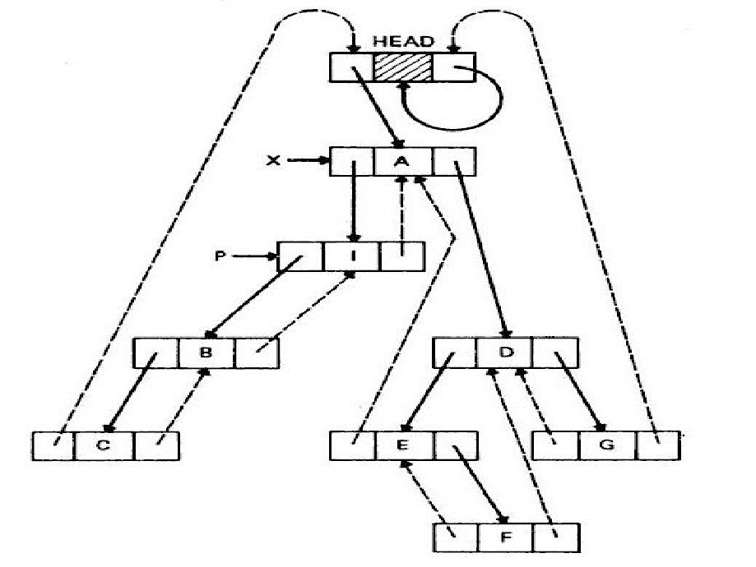
37

Slide 71
Conversion of General Tree to Binary Tree
A general tree can have any number of nodes.
To represent general trees as binary trees , two pointers are maintained. One pointer points to the first child of the node and the other pointer points to the siblings of the node.
The structure of the node in the general tree can be defined as:
struct gen
{
int data;
struct gen *fchild;
struct gen *sibling;
};

Slide 72
Conversion of General Tree to Binary Tree
Following are the steps of converting given General tree into Binary tree:
As a first step we delete all the branches originating in every node except the left most branch.
We draw edges from a node to the node on the right, if any, which is situated at the same level.
Once it is done, then for any node we choose its left and right children in the following manner:
The left child id the node, which is immediately below the given node, and the right child is the node to the immediate right of the given node on the same horizontal line.

Slide 73
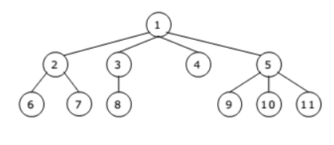
Conversion of General Tree to Binary Tree
Example-1: General Tree given:

Slide 74
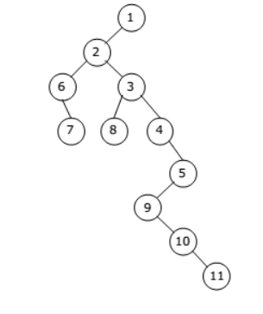
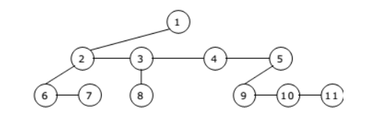
Conversion of General Tree to Binary Tree
Example-1: Binary Tree of the given General Tree

Slide 75
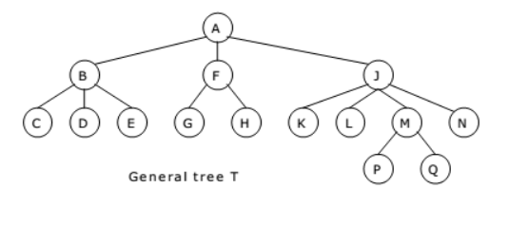
Conversion of General Tree to Binary Tree
Example-2: General Tree given:

Slide 76
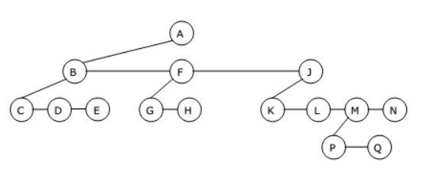
Conversion of General Tree to Binary Tree
Example-2 : Binary Tree of the given General Tree

Slide 77
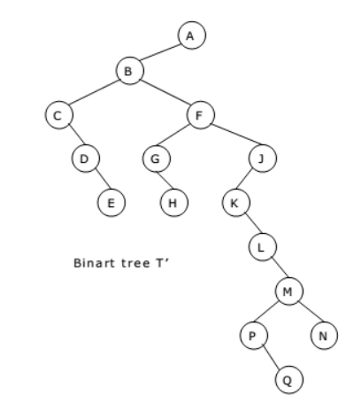
Conversion of General Tree to Binary Tree
Example-2 : Binary Tree of the given General Tree

Slide 78
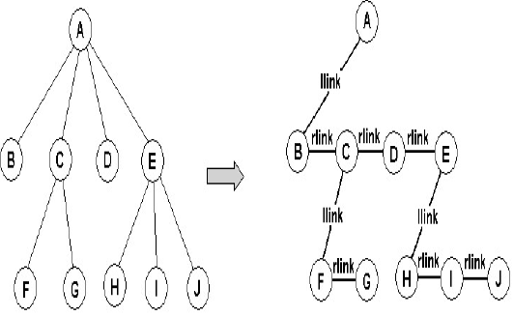
Conversion of General Tree to Binary Tree

Slide 79
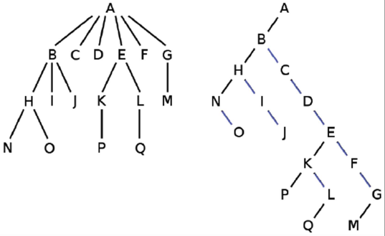
Conversion of General Tree to Binary Tree

Slide 80
Applications of Trees
Expression tree
Multi-linked structure – sparse matrices

Slide 81
Binary Search Tree
Binary Search Tree is a node-based binary tree data structure which has the following properties:
The left subtree of a node contains only nodes with keys lesser than the node’s key.
The right subtree of a node contains only nodes with keys greater than the node’s key.
The left and right subtree each must also be a binary search tree.
A Binary Search Tree is a binary tree where each node’s left subtree has smaller values and the right subtree has larger values.

Slide 82
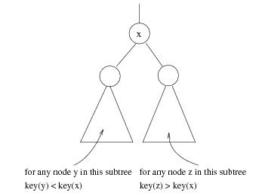
Binary Search Tree
Stores keys in the nodes in a way so that searching, insertion and deletion can be done efficiently.
• Binary search tree property
• For every node X, all the keys in its left subtree are smaller than the key value
in X, and all the keys in its right subtree are larger than the key value in X

Slide 83
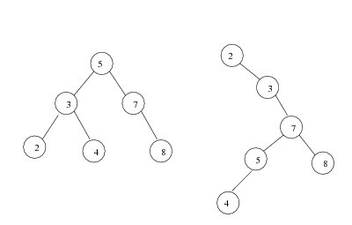
Binary Search Tree
Average depth of a node is O(log N); maximum depth of a node is O(N)
Two binary search trees representing the same set:

Slide 84
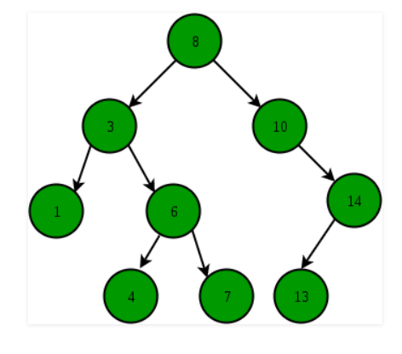

Slide 85
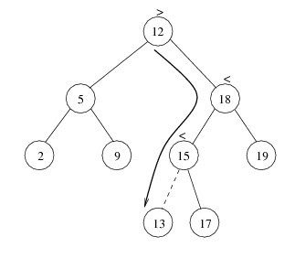
Binary Search Tree
insert
Proceed down the tree as you would with a find
If X is found, do nothing (or update something)
Otherwise, insert X at the last spot on the path traversed
Time complexity = O(height of the tree)

Slide 86
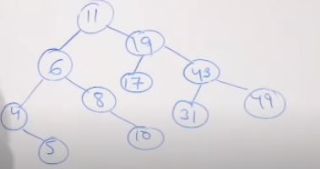
Binary Search Tree
Elements are
11,6,8,19,4,10,5,17,43,49,31

Slide 87

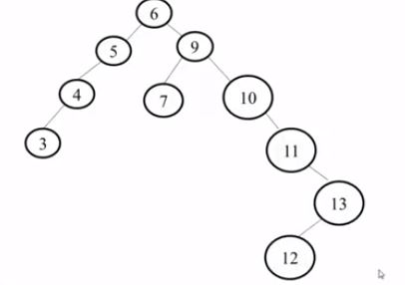
Binary Search Tree
Elements are

Slide 88
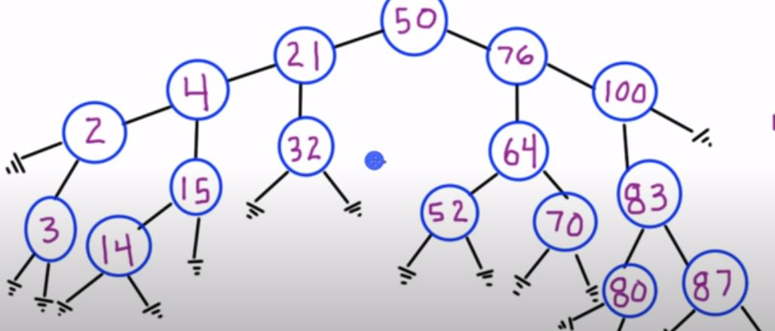
Binary Search Tree
Elements are
50,76,21,4,32,64,15,52,14,100,83,2,3,70,87,80

Slide 89
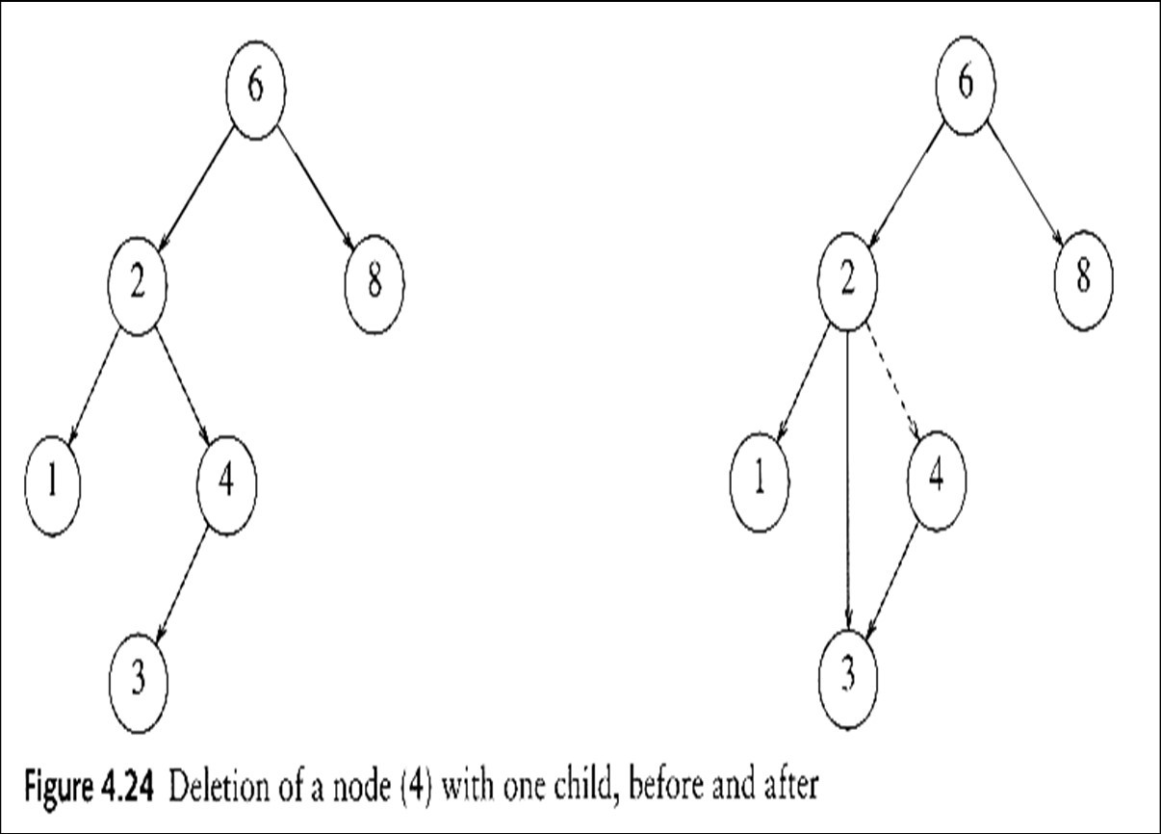
Binary Search Tree
delete
When we delete a node, we
need to consider how we take
care of the children of the deleted node.
This has to be done such that
the property of the search tree is maintained.
Three cases:
the node is a leaf
  Delete it immediately
the node has one child
  Adjust a pointer from the parent to bypass that node

Slide 90
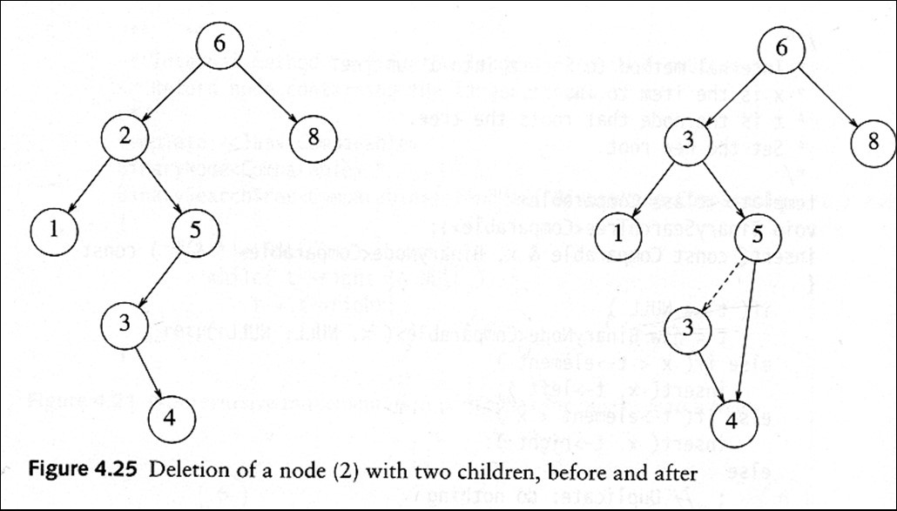
Binary Search Tree
(3) the node has 2 children
replace the key of that node with the minimum element at the right subtree
delete the minimum element
Time complexity = O(height of the tree)

Slide 91
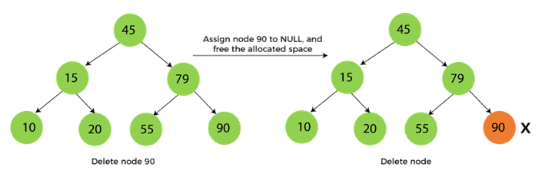
Binary Search Tree
When the node to be deleted is the leaf node

Slide 92
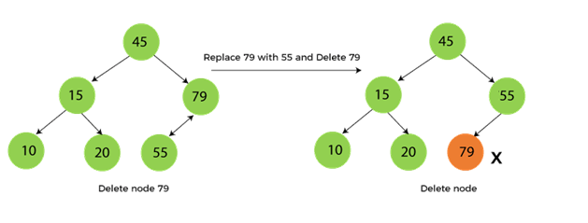
Binary Search Tree
When the node to be deleted has only one child

Slide 93
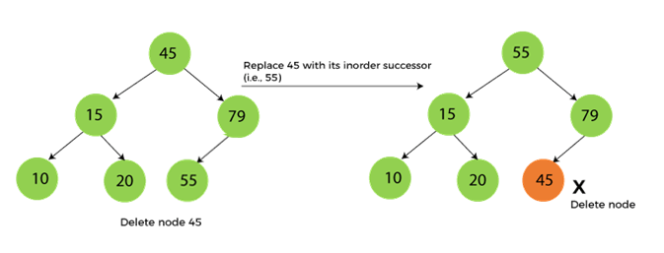
Binary Search Tree
When the node to be deleted has two children
First, find the inorder successor of the node to be deleted.
After that, replace that node with the inorder successor until the target node is placed at the leaf of tree.
And at last, replace the node with NULL and free up the allocated space.

Slide 94
AVL TREE
AVL Tree can be defined as height balanced binary search tree in which each node is associated with a balance factor which is calculated by subtracting the height of its right sub-tree from that of its left sub-tree.
Tree is said to be balanced if balance factor of each node is in between -1 ,0, 1 otherwise, the tree will be unbalanced and need to be balanced.
Balance Factor (k) = height (left(k)) - height (right(k))

Slide 95
AVL TREE
The balance factor of any node is calculated by
subtracting the height of the right sub-tree of the
node from the height of the left sub-tree .
The structure of a node of an AVL tree is given
below :
struct AVL
{
struct AVL *left;
int data;
struct AVL *right;
int balfact;
}

Slide 96
AVL TREE
The value of balfact of any node is -1,0 or 1. If it is other than these three values then the tree is
not balanced or it is not an AVL tree.
If balance factor of any node is 1, it means that the left sub-tree is one level higher than the right sub-tree.
If balance factor of any node is 0, it means that the left sub-tree and right sub-tree contain equal height.
If balance factor of any node is -1, it means that the left sub-tree is one level lower than the right sub-tree.

Slide 97
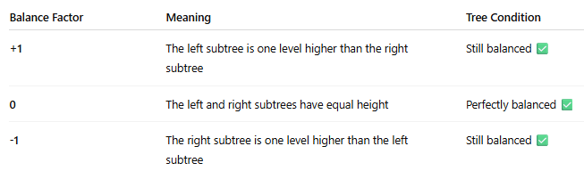

Slide 98
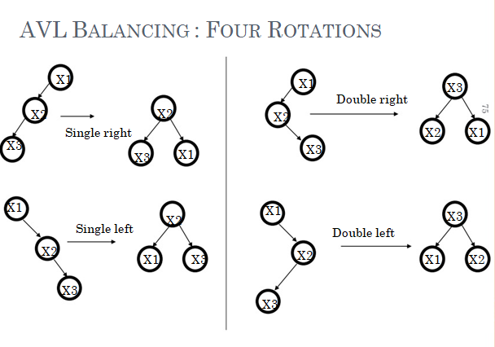
AVL TREE

Slide 99
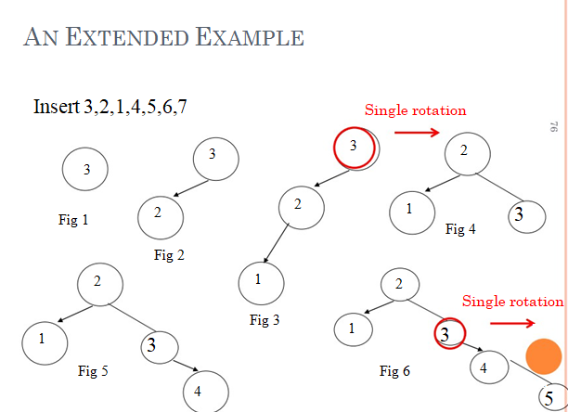
AVL TREE

Slide 100
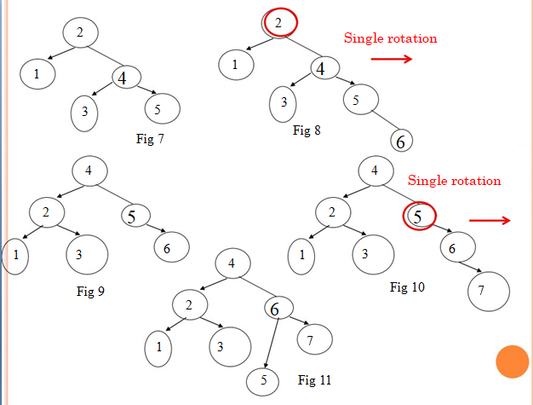
AVL TREE

Slide 101
B TREE
Definition of B-Tree :-
B-tree is a multi-way search tree of order n that satisfies the following conditions :
All the non-leaf nodes(except root node) have at least n/2 children and at the most n children.
The non-leaf root node may have at the most n non- empty child and at least two child nodes.
A B-tree can exist with only one node i.e the root node containing no child.
Balanced Sort(Tree) is known as B-Tree

Slide 102
B TREE
If a node has n children then it must have n-1 values. All the values of a particular node are in increasing order.
All the values that appear on the left most child of a node are smaller than the first value of that node. All the values that appear on the right most child of a node are greater than the last value of that node.
All the leaf nodes should appear on the same level..
B-Tree is a self-balancing multi-way search tree in which data is stored in sorted order and all leaf nodes are at the same level.

Slide 103
B TREE
Draw B-Tree Order 3 using following elements :
20 30 35 85 10 55 60 25

Slide 104
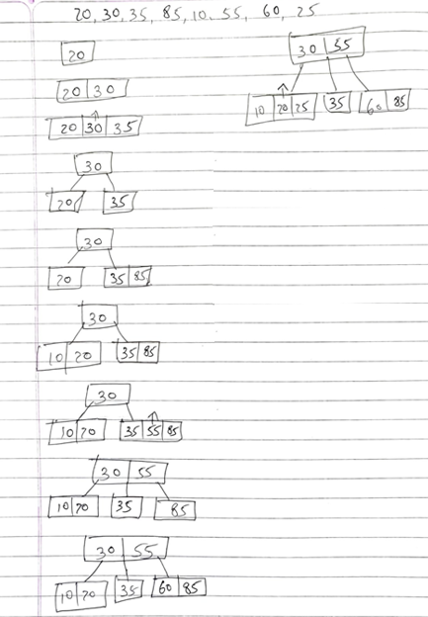
B TREE

Slide 105
Basic Terminologies
Graph :
A graph is basically, “a collection of vertices (also called nodes) and edges that connect these vertices”.
A graph is often viewed as a generalization of the tree structure, where instead of a having a purely parent-to-child relationship between tree nodes, any kind of complex relationships between the nodes can be represented.
A graph G=<V,E> is defined as an ordered set (V,E),where V(G) represents set of vertices and E(G) represents the edges that connect the vertices.

Slide 106

Basic Terminologies
Graph :
The figure given shows a graph with V(G) = { A, B, C, D and E} and E(G) = { (A, B), (B, C), (A, D), (B, D), (D, E), (C, E) }. Note that there are 5 vertices or nodes and 6 edges in the graph.

Slide 107
Basic Terminologies
Adjacent Nodes:
Any two nodes which are connected by an edge in a graph are called Adjacent nodes.
Directed Edge and Undirected Edge:
In a graph G = (V,E), an edge which is directed from one node to another is called a directed edge, while an edge which has no specific direction is called an undirected edge.

Slide 108
Basic Terminologies
Directed Graph :
A graph in which every edge is directed is called a directed graph or diagraph.
Undirected Graph :
A graph in which every edge is undirected is called an undirected graph.
Mixed Graph:
A graph in which some of the edges are directed and some are undirected is called mixed graph.

Slide 109
Basic Terminologies
Loop or Sling :
An edge of a graph which joins a node to itself is called a loop.
Tree :
A tree consists of finite set of elements called nodes, and finite set of directed lines, called branches, that connect the nodes.

Slide 110
Basic Terminologies
Parallel Edges:
Distinct edges which connect the same end points are called Parallel edges.
Distinct edges :
In the case of directed edges, the two possible edges between a pair of nodes which are opposite in direction are considered distinct.

Slide 111
Basic Terminologies
Multigraph :
Any graph which contains some parallel edges is called a multigraph.
Simple graph:
If a graph does not contain any parallel edges or loop then it is Simple graph.
Multiplicity :
In graph, number on any edge shows the multiplicity of the edge.
We may also consider the multiplicity as a weight
assigned to an edge.

Slide 112
Basic Terminologies
Weighted Graph:
A graph in which weights are assigned to every edge is called weighted graph.
Isolated Node :
In a graph, a node which is not adjacent to any
other node is called an isolated graph.
Null Graph :
A graph containing only isolated nodes is called
a null graph.

Slide 113
Basic Terminologies
Sub Graph
Let G be a graph with vertex set V(G) and edge-list E(G). A subgraph of G is a graph all of whose vertices belong to V(G) and all of whose edges belong to E(G).
Cycle Graph:
A cycle graph is a graph consisting of a single cycle. The cycle graph with n vertices is denoted by C_{n}.
Acyclic Graph:
A simple diagraph which does not have any cycle is called acyclic graph.

Slide 114
Basic Terminologies
Path:
A path of length n from u to v, where n is a
positive integer, in an undirected graph is a
sequence of edges e₁, e₂, …, e_{n} of the graph such
that e₁ = {x₀, x₁}, e₂ = {x₁, x₂}, …, e_{n} = {x_{n-1}, x_{n}},
where x₀ = u and x_{n} = v.
Circuit :
The path is a circuit if it begins and
ends at the same vertex, that is, if u = v.

Slide 115

Basic Terminologies
Wheels:
The wheel graph W_{n} is just a
cycle graph with an extra vertex in the middle.
Degree :
Degree of a node u, deg(u), is the total number of edges containing the node u.
Length :
The no. of edges appearing in the
sequence of a path is called the length of the
path.

Slide 116
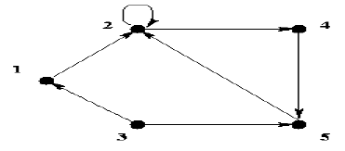
Basic Terminologies
Simple path :- A path in a diagraph in which the edges are distinct is called simple path
Elementary path :- A path in which all the nodes through which it traverses are distinct is called an elementary path (node simple).
Note :- Every elementary path of a digraph is also simple.
Example of simple and elementary path : 1, 2, 5 is a simple and elementary path ,
1, 2, 2, 5 is a simple path but not elementary.
1, 2, 4, 5 is a simple elementary path,
1, 2, 4, 5, 2, 4, 5 is not simple (hence not elementary),

Slide 117
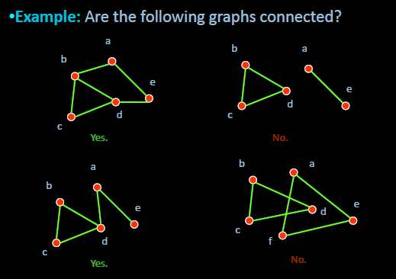
Basic Terminologies
Connected Graph: An undirected graph is called connected if there is a path between every pair of distinct vertices in the graph.
•For example, any two computers in a network can communicate if and only if the graph of this network is connected.
•Note: A graph consisting of only one vertex is always connected, because it does not contain any pair of distinct vertices.

Slide 118
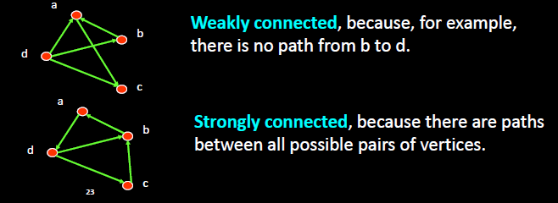
Basic Terminologies
Strongly Connected Graph:
An directed graph is strongly connected if there is a path from a to b and from b to a whenever a and b are vertices in the graph.
Weakly Connected Graph:
An directed graph is weakly connected if there is a path between any two vertices in the underlying undirected graph.

Slide 119
Representation of a Graph
There are two common ways of storing graphs in computer’s memory.
Sequential Representation - Adjacency Matrix (Static)
Linked Representation - Adjacency List (Dynamic)

Slide 120
Adjacency Matrix
An adjacency matrix is used to represent which nodes are adjacent to one another. By definition, we have learnt that, two nodes are said to be adjacent if there is an edge connecting them.
In a directed graph G, if node v is adjacent to node u, then surely there is an edge from u to v. That is, if v is adjacent to u, we can get from u to v by traversing one edge. For any graph G having n nodes, the adjacency matrix will have dimensions of n x n.
In an adjacency matrix, the rows and columns are labeled by graph vertices. An entry a_{ij} in the adjacency matrix will contain 1, if vertices v_{i} and v_{j} are adjacent to each other. However, if the nodes are not adjacent, a_{ij} will be set to zero.

Slide 121
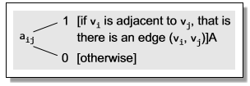
Adjacency Matrix
Since an adjacency matrix contains only 0s and 1s, it is called a Bit Matrix or a Boolean Matrix.
The entries in the matrix depend on the ordering of the nodes in G.
Therefore, a change in the order of nodes will result in a different adjacency matrix.

Slide 122
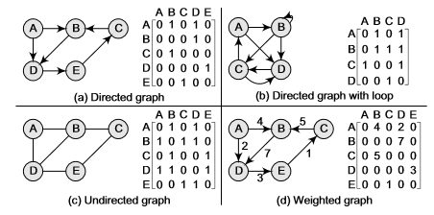
Adjacency Matrix

Slide 123

Adjacency List
The adjacency list is another way in which graphs can be represented in computer’s memory.
This structure consists of a list of all nodes in G.
Furthermore, every node is in turn linked to its own list that contains the names of all other nodes that are adjacent to itself.

Slide 124

Adjacency List

Slide 125
BFS
BFS stands for Breadth First Search is a vertex based technique for finding a shortest path in graph. It uses a Queue data structure which follows first in first out. In BFS, one vertex is selected at a time when it is visited and marked then its adjacent are visited and stored in the queue.
Breadth First Search (BFS) algorithm traverses a graph in a breadthward motion and uses a queue to remember to get the next vertex to start a search, when a dead end occurs in any iteration.

Slide 126
BFS
Breadth-first search (BFS) is a graph search algorithm that begins at the root node and explores all
the neighbouring nodes. Then for each of those nearest nodes, the algorithm (Fig. 13.20) explores
their unexplored neighbour nodes, and so on, until it finds the goal.

Slide 127

BFS

Slide 128
BFS
That is, we start examining the node A and then all the neighbours of A are examined. In the next step, we examine the neighbours of neighbours of A, so on and so forth. This means that we need to track the neighbours of the node and guarantee that every node in the graph is processed and no node is processed more than once. This is accomplished by using a queue that will hold the nodes that are waiting for further processing and a variable STATUS to represent the current state of the node.

Slide 129

BFS

Slide 130
BFS
Consider the graph G given in Fig. 13.21. The adjacency list of G is also given. Assume that G represents the daily flights between different cities and we want to fly from city A to I with minimum stops. That is, find the minimum path P from A to I given that every edge has a length of 1.
The minimum path P can be found by applying the breadth-first search algorithm that begins at city A and
ends when I is encountered. During the execution of the algorithm, we use two arrays:
QUEUE and ORIG.
While QUEUE is used to hold the nodes that have to be processed, ORIG is used to keep track of the origin of each edge. Initially, FRONT = REAR = –1.

Slide 131


BFS

Slide 132

BFS

Slide 133

BFS
BFS TRAVERSAL OF GRAPH : A C E B F D

Slide 134
DFS
Depth First Search (DFS) algorithm traverses a graph in a depthward motion and uses a stack to remember to get the next vertex to start a search, when a dead end occurs in any iteration.
The depth-first search algorithm (Fig. 13.22) progresses by expanding the starting node of G and then going deeper and deeper until the goal node is found, or until a node that has no children is encountered. When a dead-end is reached, the algorithm backtracks, returning to the most recent node that has not been completely explored.

Slide 135

DFS

Slide 136
DFS
In other words, depth-first search begins at a starting node A which becomes the current node.Then, it examines each node N along a path P which begins at A. That is, we process a neighbour of A, then a neighbour of neighbour of A, and so on. During the execution of the algorithm, if we reach a path that has a node N that has already been processed, then we backtrack to the current node. Otherwise, the unvisited (unprocessed) node becomes the current node.

Slide 137
DFS
The algorithm proceeds like this until we reach a dead-end (end of path P). On reaching the deadend, we backtrack to find another path P¢. The algorithm terminates when backtracking leads back to the starting node A. In this algorithm, edges that lead to a new vertex are called discovery edges and edges that lead to an already visited vertex are called back edges.

Slide 138

DFS
Consider the graph G given in Fig. 13.23. The adjacency list of G is also given. Suppose we want to print all the nodes that can be reached from the node H (including H itself). One alternative is to use a depth-first search of G starting at node H.

Slide 139

DFS

Slide 140

DFS

Slide 141

DFS
DFS TRAVERSAL OF GRAPH : A C B F D E

Slide 142



BFS | DFS
BFS Stands for “Breadth First Search”. | DFS stands for “Depth First Search”.
BFS starts traversal from the root node and then explore the search in the level by level manner i.e. as close as possible from the root node. | DFS starts the traversal from the root node and explore the search as far as possible from the root node i.e. depth wise.
Breadth First Search can be done with the help of queue i.e. FIFO implementation. | Depth First Search can be done with the help of Stack i.e. LIFO implementations.
This algorithm works in single stage. The visited vertices are removed from the queue and then displayed at once. | This algorithm works in two stages – in the first stage the visited vertices are pushed onto the stack and later on when there is no vertex further to visit those are popped-off.
BFS is slower than DFS. | DFS is more faster than BFS.
BFS requires more memory compare to DFS. | DFS require less memory compare to BFS.
BFS is useful in finding shortest path.BFS can be used to find the shortest distance between some starting node and the remaining nodes of the graph. | DFS in not so useful in finding shortest path. It is used to perform a traversal of a general graph and the idea of DFS is to make a path as long as possible, and then go back (backtrack) to add branches also as long as possible.
Ex. | Ex.
36

Slide 143

Spanning tree
Spanning tree - A spanning tree is the subgraph of an undirected connected graph.
Minimum Spanning tree - Minimum spanning tree can be defined as the spanning tree in which the sum of the weights of the edge is minimum. The weight of the spanning tree is the sum of the weights given to the edges of the spanning tree.

Slide 144
Prim's Algorithm
Prim's Algorithm is a greedy algorithm that is used to find the minimum spanning tree from a graph. Prim's algorithm finds the subset of edges that includes every vertex of the graph such that the sum of the weights of the edges can be minimized.
Prim's algorithm starts with the single node and explores all the adjacent nodes with all the connecting edges at every step. The edges with the minimal weights causing no cycles in the graph got selected.

Slide 145
Prim's Algorithm
How does the prim's algorithm work?
The algorithm starts with a single node.
At each step, it checks the adjacent nodes and their connecting edges.
The edge that has the smallest weight and does not form a cycle is added to the MST(Minimum Spanning Tree.).
Then, the same process is repeated from the newly added node.
The algorithm continues until all nodes are included.

Slide 146

Prim's Algorithm
Example of prim's algorithm
Now, let's see the working of prim's algorithm using an example. It will be easier to understand the prim's algorithm using an example.
Suppose, a weighted graph is -

Slide 147


Prim's Algorithm
Step 1 - First, we have to choose a vertex from the above graph. Let's choose B.
Step 2 - Now, we have to choose and add the shortest edge from vertex B. There are two edges from vertex B that are B to C with weight 10 and edge B to D with weight 4. Among the edges, the edge BD has the minimum weight. So, add it to the MST.

Slide 148

Prim's Algorithm
Step 3 - Now, again, choose the edge with the minimum weight among all the other edges. In this case, the edges DE and CD are such edges. Add them to MST and explore the adjacent of C, i.e., E and A. So, select the edge DE and add it to the MST.

Slide 149

Prim's Algorithm
Step 4 - Now, select the edge CD, and add it to the MST.

Slide 150

Prim's Algorithm
Step 5 - Now, choose the edge CA. Here, we cannot select the edge CE as it would create a cycle to the graph. So, choose the edge CA and add it to the MST.

Slide 151
Prim's Algorithm
So, the graph produced in step 5 is the minimum spanning tree of the given graph. The cost of the MST is given below -
Cost of MST = 4 + 2 + 1 + 3 = 10 units.

Slide 152

Prim's Algorithm

Slide 153
Kruskal's Algorithm
Kruskal's Algorithm is used to find the minimum spanning tree for a connected weighted graph. The main target of the algorithm is to find the subset of edges by using which we can traverse every vertex of the graph.
It follows the greedy approach that finds an optimum solution at every stage instead of focusing on a global optimum.

Slide 154
Kruskal's Algorithm
How does Kruskal's algorithm work?
In Kruskal's algorithm, we start from edges with the lowest weight and keep adding the edges until the goal is reached. The steps to implement Kruskal's algorithm are listed as follows –
First, sort all the edges from low weight to high.
Now, take the edge with the lowest weight and add it to the spanning tree. If the edge to be added creates a cycle, then reject the edge.
Continue to add the edges until we reach all vertices, and a minimum spanning tree is created.

Slide 155

Kruskal's Algorithm

Slide 156


Kruskal's Algorithm

Slide 157


Kruskal's Algorithm

Slide 158

Kruskal's Algorithm

Slide 159

Kruskal's Algorithm

Slide 160


Kruskal's Algorithm

Slide 161

Kruskal's Algorithm

Slide 162
Dijkstra Algorithm (SHORTEST PATH ALGORITHM )
Dijkstra algorithm is a single-source shortest path algorithm. Here, single-source means that only one source is given, and we have to find the shortest path from the source to all the nodes.
A weighted graph is a graph where the values are assigned to the edges and the length of a path is sum of the weight of the edges in the path.
In a weighted graph, we often need to find the shortest path.
The shortest path between two given vertices is the
path having minimum length.
This problem can be solved by one of the greedy algorithms, by Edger W. Dijkstra, often called as Dijkstra’s algorithm.

Slide 163
Dijkstra Algorithm (SHORTEST PATH ALGORITHM )
The distance of a vertex v from a vertex s is the length of a shortest path between s and v
Dijkstra’s algorithm computes the distances of all the vertices from a given start vertex s.
Prim’s algorithm creates a minimum spanning tree, whereas Dijkstra’s algorithm finds the shortest path.

Slide 164

Dijkstra Algorithm (SHORTEST PATH ALGORITHM )

Slide 165

Dijkstra Algorithm (SHORTEST PATH ALGORITHM )

Slide 166
Thank You...!!!!

